Slide 1
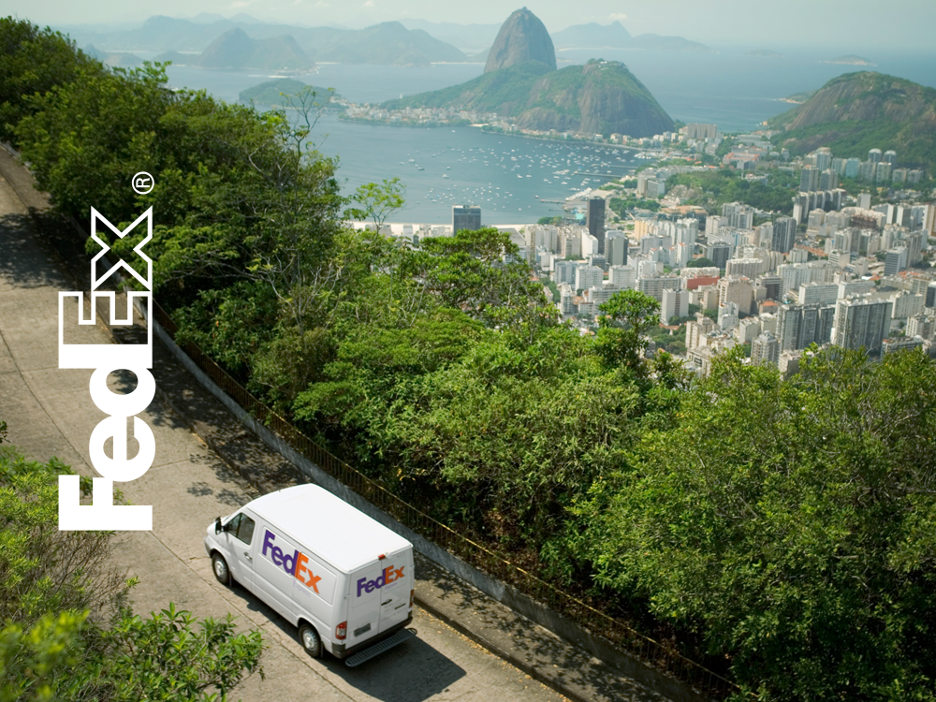
FOOTPRINT
CAPABILITIES

Slide 2



Força Local, Alcance Global

Slide 3
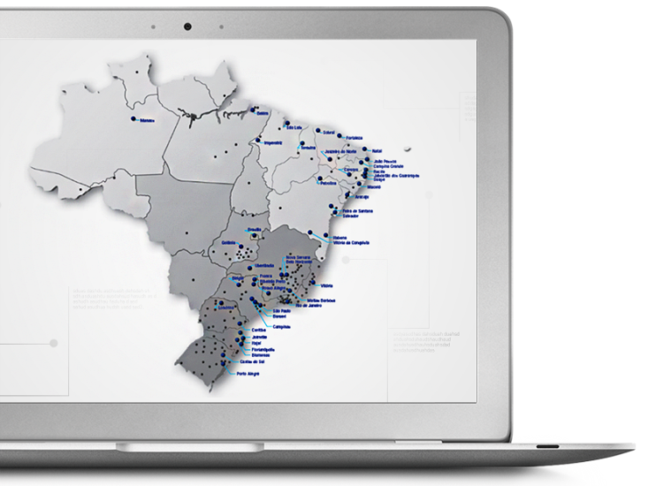
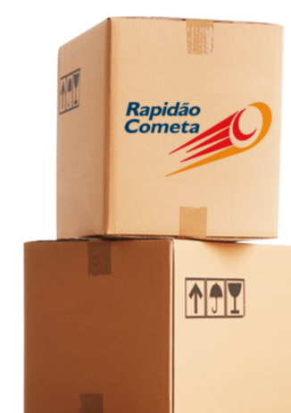
FedEx Brazil – Domestic Coverage
Rapidão Cometa - 3,500 cities and 96% of total territory covered
BRANCH
OPERATIONS AREA

Slide 4



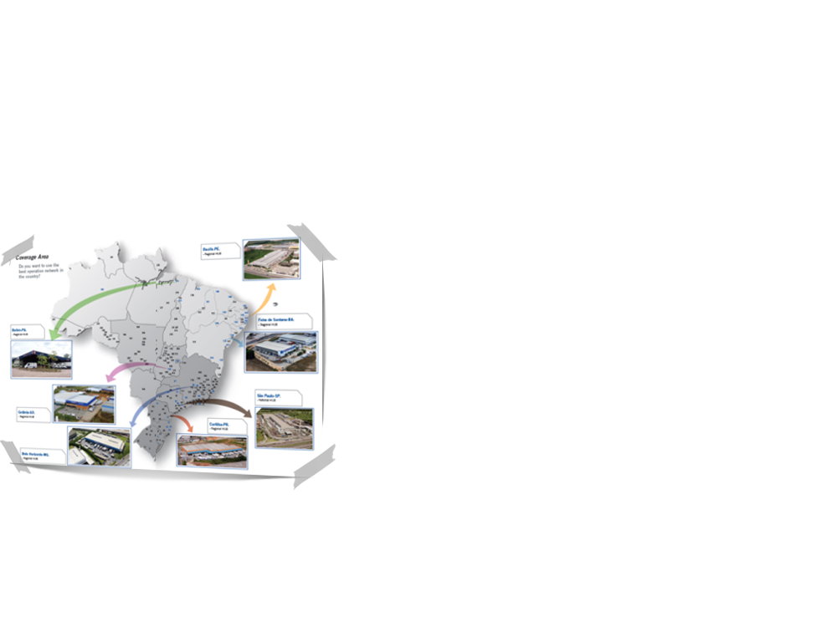
FedEx Brazil – Domestic Warehousing
Rapidão Cometa
 | TOTAL AREA | BUILT AREA | DOCKS
Belém/ PA | 18 mil m² | 5,6 mil m² | 36
Belo horizonte/MG | 26 mil m² | 5 mil m² | 50
Blumenau/SC | 6 mil m² | 2 mil m² | 16
Brasilia/DF | 10 mil m² | 2,7 mil m² | 10
Campinas/SP | 19 mil m² | 5,2 mil m² | 60
Curitiba/PR | 6 mil m² | 3,2 mil m² | 15
Fortaleza/CE | 25 mil m² | 9 mil m² | 51
Manaus/AM | 80 mil m² | 30 mil m² | 76
Matias Barbosa/MG | 10 mil m² | 8 mil m² | 10
Porto Alegre/RS | 14,5 mil m² | 4 mil m² | 24
Recife/PE | 62 mil m² | 27 mil m² | 84
Rio de Janeiro/RJ | 25 mil m² | 18 mil m² | 54
São Paulo/SP | 65 mil m² | 25 mil m² | 120

Slide 5


FedEx Brazil – Domestic Warehousing
Rapidão Cometa
To ensure the security of your cargo 24/7, we use two systems especially designed for external and internal risk management:
SEPAT
Asset Protection System (Serviço de Proteção ao Patrimônio) which is responsible for internal risk management, product integrity and asset security
SENOP
National Operations System (Serviço Nacional de Operações) which accounts for external risk management and provides satellite monitoring for the entire pickup, delivery fleet transfer
Risk Management Committee
Own staff members, experts and risk management technicians from Pamcary carry out surveys and studies on hazardous areas and most targeted products, thus avoiding risk concentration

Slide 6



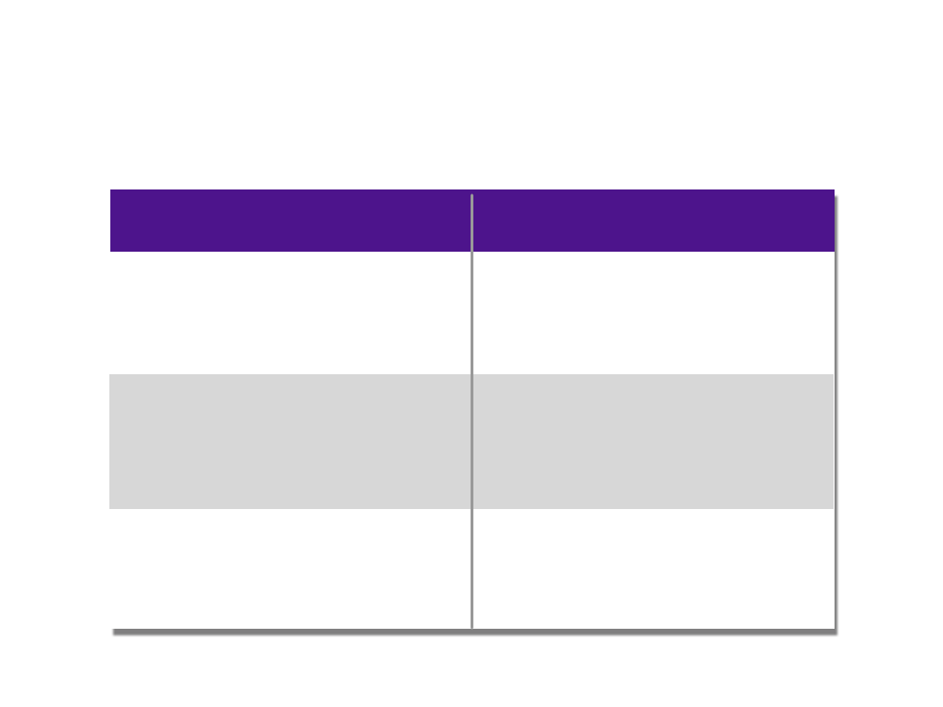






FedEx Brazil – Domestic Warehousing
Rapidão Cometa
EXTERNAL RISK MANAGEMENT | INTERNAL RISK MANAGEMENT
VEHICLE MONITORING SYSTEM Permanent satellite-enabled fleet tracking system Omnisat – and Omnilink via cellphone – used for pick-up, delivery and fleet transfer | ASSET SECURITY Rapidão Cometa’s branch offices are supported by security companies that specialize in internal risk management and guarantee the integrity of your goods
CARGO GUARDIAN ANGEL Cargo retrieval location system. The communication chip is placed among the products for identification and location purposes when a casualty occurs | ACCESS CONTROL SYSTEM A modern fully automated access control system ensures access to the branch offices is restricted to authorized persons only, remote monitoring included
ARMED ESCORT Performed by the best security companies in the market, with appropriate vehicles and specially trained staff | CCTV (CLOSED CIRCUIT TV) A modern around-the-clock monitoring system watches all goods and processes within the DC and ensures remote image filing

Slide 7








FedEx Brazil – IT Systems
Rapidão Cometa
Rapidão develops IT systems to bring value to your business
Applications developed for integration with customers’ own corporate systems, standard EDI or customized solutions with internet visibility
EDI (Electronic Data Interchange)
TMS
We use EDI to exchange information with customers and vendors to ensure high quality proccesses, speed, safety and confidence
Interlinked applications that cover all operational and management activities, providing the support necessary for best customer service
WMS
ERP
The Warehouse Management System is used to automate and expedite all processes related to incoming products, inspections, storage, kitting, picking, packing, inventory, shipping of products and billing of services
The back office management tool system used by the company is ERP Oracle Applications. The main components are Human Resources, Finances and Accounting.
Tax
Rapidão Log
The solution for duties and tax management not only adds the historical data of fiscal activities, but also complies with federal, state and city regulations
Rapidão Cometa developed a tool for online follow-up of all logistics services

Slide 8
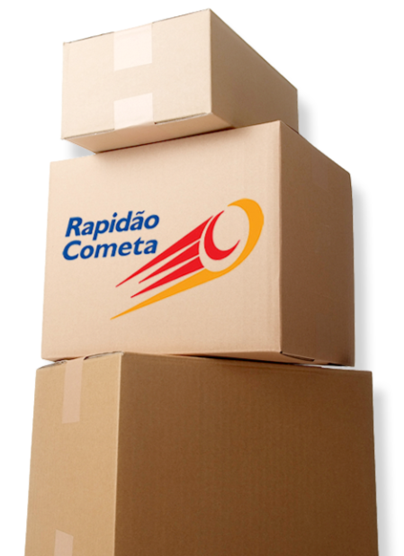








FedEx Brazil – Domestic Portfolio
Air
Ground
Logistics
B2C

Slide 9


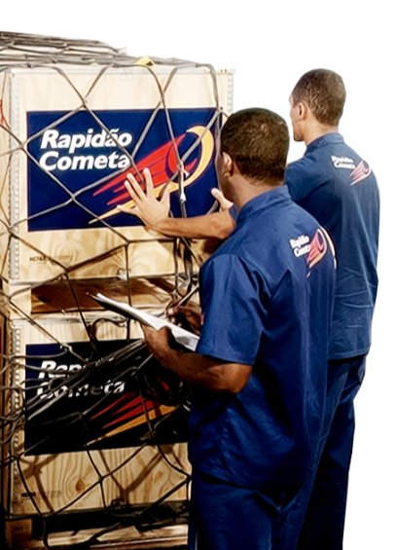
FedEx Brazil – Domestic Portfolio
Air
We serve all cities in Brazil that have airports, with transit times between 24-72 hours
Aéreo Colo a Colo Rapidão Cometa’s most urgent service
Aéreo Pequenos Volumes The best option to ship small packages from 100 grams to 8 kgs
Aéreo Expresso Transportation for shipments that need to arrive at their destination quickly and safely
Aéreo Tradicional For shipments with a delivery lead time of up to 2 business days for state capital cities and up to 3 business days for all other locations

Slide 10
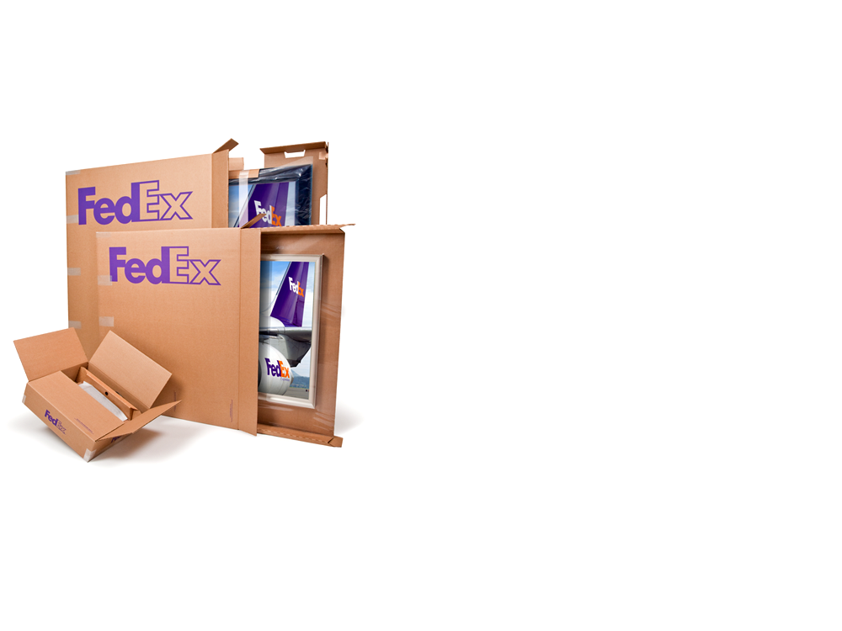



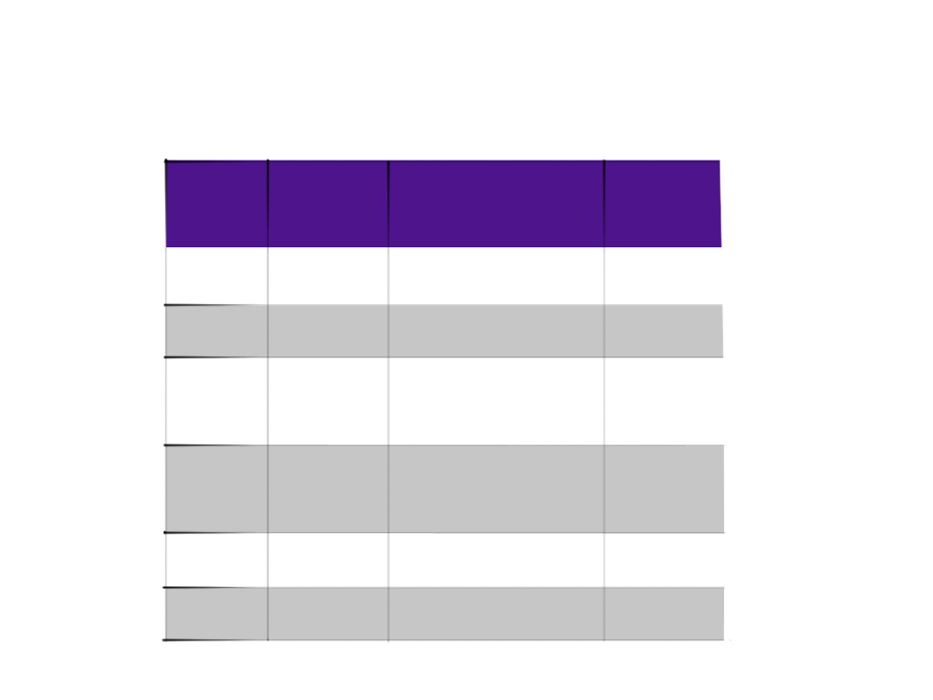
FedEx Brazil – Domestic Portfolio
Air
Strategic Alliances
COMPANY | MAX WEIGHT/ VOLUME (KG) | NETWORK | SERVICES
TAM | 150 | NATIONAL | EXPRESS, CONVENTIONAL
GOLLOG | 80 | NATIONAL | EXPRESS, CONVENTIONAL
AVIANCA | 100 | BSB, CGB, CGR, CNF, CWB, FLN, FOR, JDO, PNZ, POA, PVH, REC, SDU, SÃO, SSA e XAP | CONVENTIONAL
AZUL | 70 | CPQ, SÃO, FOR,REC, MCZ, MAO, BSB, GYN, SSA, CGB, CGR, CNF, CWB, FLN, NAT, NVT, POA, VIX | EXPRESS
WEBJET | 120 | POA, CWB, GRU, GIG, CNF, SSA, BSB, REC, NAT e FOR | CONVENTIONAL
ABSA | 4.000 | SÃO, MAO, REC e FOR | CONVENTIONAL, CHARTER
EXPRESS SERVICE: Next flight - CONVENTIONAL SERVICE: 48h

Slide 11


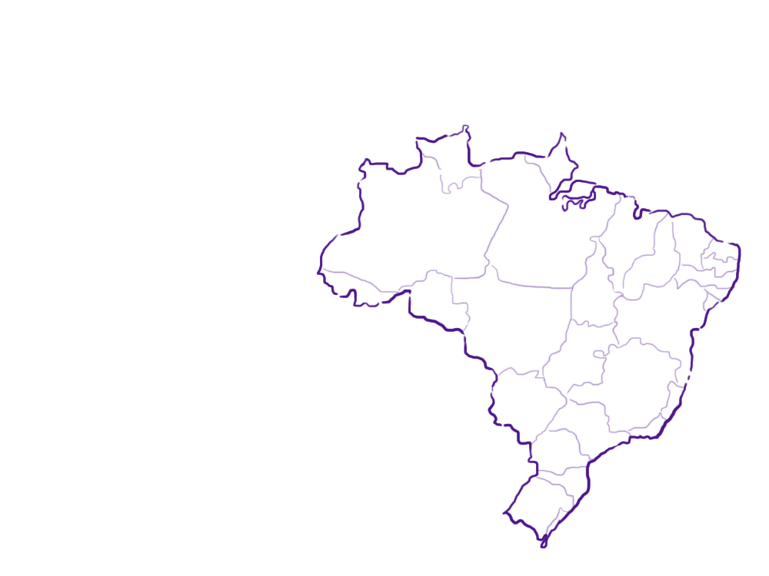
FedEx Brazil – Domestic Portfolio
Ground
Rapidão Rodo Regional Your freight will be shipped quickly and safely within the same region
Rapidão Rodo Inter-Regional A freight transportation service that connects all regions in the country with the support of a network of terminals and fleet vehicles, with the additional benefit of extensive knowledge of the specific features of each region
Rapidão 1a Hora Inter-Regional A road freight express service for small consignments with high added value, it is also Rapidão Cometa’s fastest ground transportation service
Notes:
Rapidão Rodo Regional - Se sua necessidade é melhorar a distribuição em sua região, contrate o Rapidão Rodo Regional. Com ele, você envia sua carga de forma rápida e segura dentro de uma mesma região. O Rapidão Rodo Regional coloca à disposição da sua empresa o melhor desempenho de entrega do mercado e o menor tempo possível.
Rapidão Rodo Inter-Regional - Ideal para quem tem a necessidade de atingir novos mercados, ampliando a área de atendimento em outras regiões. O Rapidão Rodo Inter-Regional é o serviço de transporte de carga que interliga todas as regiões do país, através de uma infra-estrutura de terminais e de frotas, além de possuir o conhecimento das particularidades de cada região.
Rapidão 1a Hora Inter-Regional - Serviço rodoviário de carga expressa para pequenas encomendas de alto valor agregado do Rapidão Rodo Inter-Regional e é também o transporte rodoviário mais veloz do Rapidão Cometa. Com ele, você conta com uma estrutura dedicada nas filiais de origem e destino, transferência ininterrupta, monitoramento constante e entrega dedicada que permite reduzir de 1 a 2 dias o prazo de entrega em relação ao Rapidão Rodo Inter-Regional.
11

Slide 12


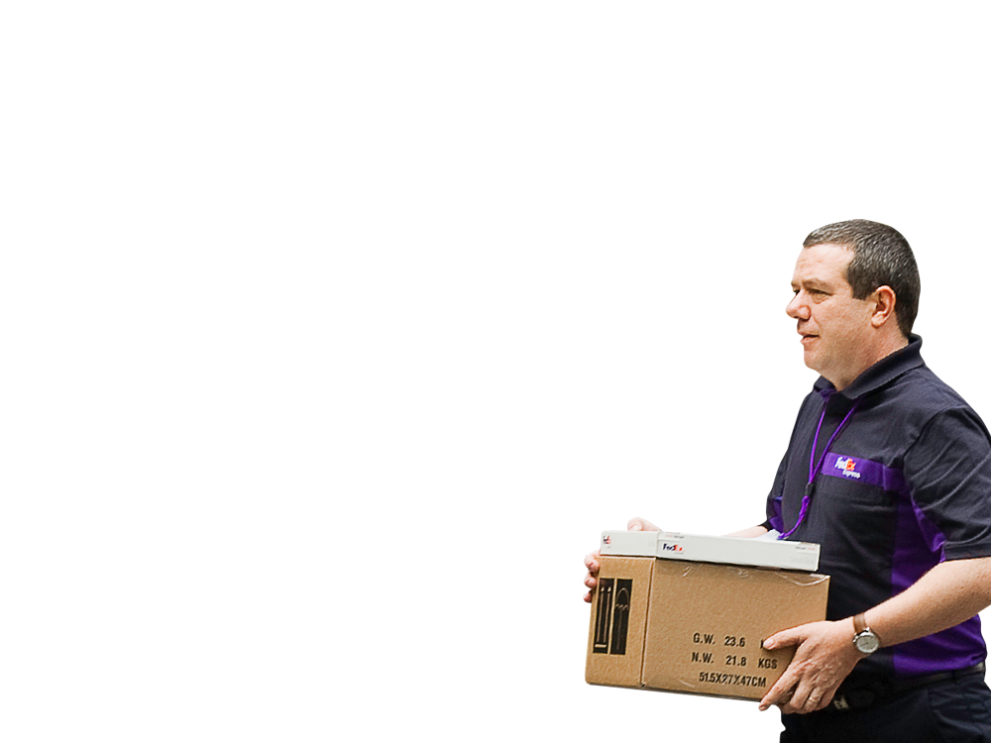





FedEx Brazil – Domestic Portfolio
Ground
Local, state, regional and national ground transportation
Comprehensive Services
Available for TL or LTL
End-to-end process visibility
Satellite-enabled monitoring system 24 hours a day, 7 days a week
End-to-end risk management
Shortest delivery lead times in the market
No weight limits for goods to be carried

Slide 13




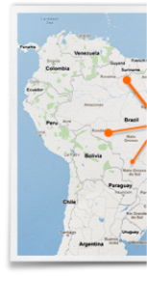
FedEx Brazil – Domestic Portfolio
Ground
Transit Times
The ground network is connected with seven main hubs where the freight is consolidated and distributed. The transit time (in days) between them is:
 |  | BEL | BHZ | CWB | FES | GYN | REC | SAO
BEL | Belem/PA | 1 | 8 | 9 | 9 | 9 | 6 | 7
BHZ | Belo Horizonte/MG | 8 | 1 | 2 | 5 | 4 | 6 | 2
CWB | Curitiba/PR | 7 | 3 | 1 | 7 | 4 | 7 | 2
FES | Feira de Santa/BA | 9 | 6 | 7 | 1 | 4 | 4 | 5
GYN | Goiania/GO | 9 | 4 | 5 | 6 | 1 | 7 | 4
REC | Recife/PE | 6 | 6 | 8 | 4 | 7 | 1 | 5
SAO | São Paulo/SP | 7 | 2 | 2 | 5 | 3 | 5 | 1

Slide 14


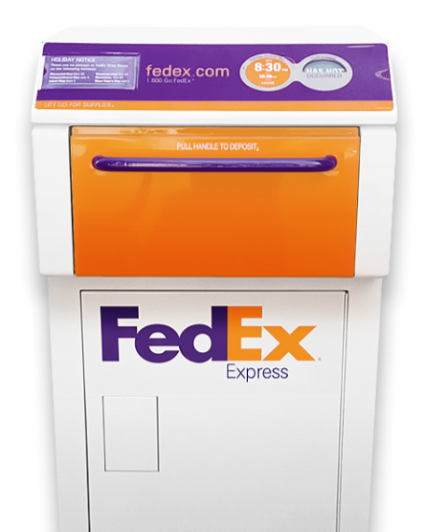

FedEx Brazil – Domestic Portfolio
Logistics
Features:
Full logistics services tailored to the needs of every step in the supply chain process
Operation at your premises or at the Rapidão Cometa’s terminals
Nationwide coverage
Customized projects according to specific customer needs
Specialized teams for the development of individual projects
Study of tax load impact on logistics solutions proposed
Service assessment through performance indicators

Slide 15





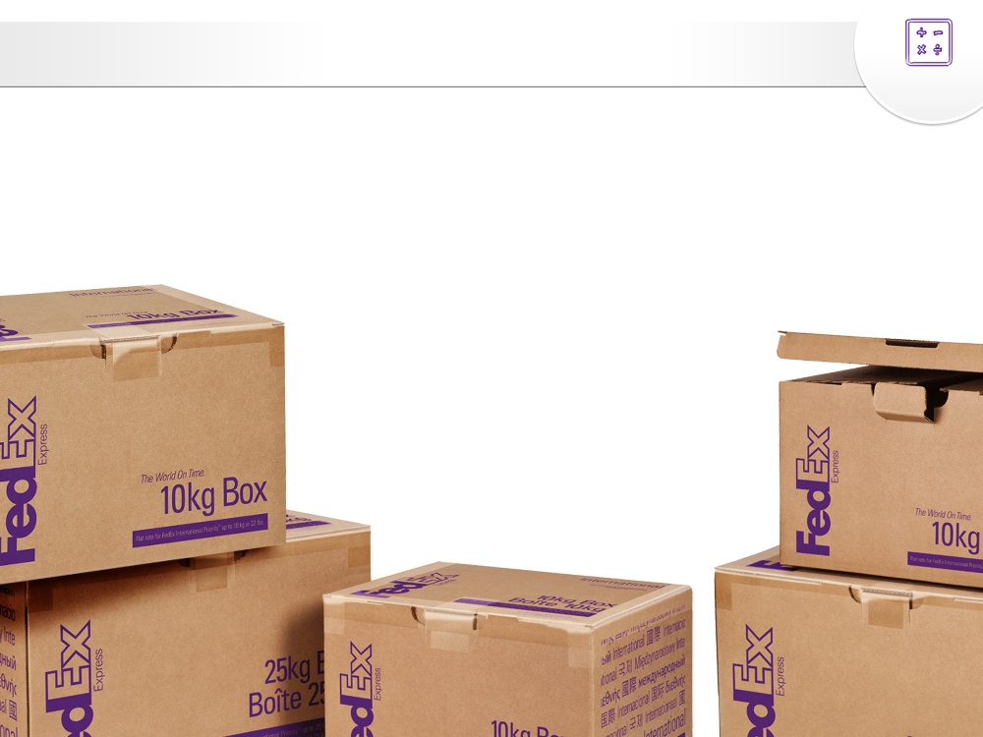






FedEx Brazil – Domestic Portfolio
Logistics
Full end-to-end inventory management, including risk monitoring and management
Order fulfillment and management – operators complete the order sequencing process, including picking, packing, packing into cartons, dispatching, kitting, configuring services, warehousing, unitizing and palletizing
Transportation Management – Development of transportation mode systems (air, road, river, ocean, railway, truckload, less-than-truckload, milk-run, multimodal operation, among others) and services according to customer requirements
Engineering and infrastructure maintenance logistics
Technical assistance logistics
Garment, shoewear and fashion logistics
Logistics for two and four-wheeled vehicles – parts and pieces
Retail logistics

Slide 16



FedEx Brazil – Domestic Portfolio
B2C
Service Characteristics
Capacity to operate consignments with a minimum weight of 100 grams, such as CDs, DVDs and books
Special rates for different weight ranges
Logistics planning development: storage, distribution, kitting, reverse logistics and customer information service
Exclusive home delivery network
Staff dedicated to home delivery
Knowledge and experience in relationship with home delivery recipients
Ability to combine Rapidão Cometa’s different transportation service modes

Slide 17







FedEx Brazil – Domestic Portfolio
B2C
Benefits
Fast Deliveries
Fast and reliable information
Precise Deliveries (consignee present at delivery)
Flexible operation: home delivery, extended hours, etc.
Proactive eletronic notification – automatic e-mails to customers

Slide 18



FedEx Brazil – Domestic Portfolio
Rapidão
Relationship Management Tools
B2C
Issue Resolution Service
EDI (Electronic Data Interchange)
Tool that allows quick resolution of possible issues within the logistics process
Allows for a large volume of electronic data interchange between companies, thereby reducing time and risk
Digital proof of delivery
Digital proof of delivery available for customers for quick and easy access
Customized Management Reports
Customers receive performance management reports that include shipment movement and delivery information
Post sales service at destination
Support issue resolution at destination
Notes:
Principais Ferramentas de Relacionamento com o Cliente
Notificação Eletrônica Pró-Ativa – Sistema automático de envio de e-mails para os clientes, informando a previsão de entrega da mercadoria e ocorrências diversas.
Relatórios Gerenciais Customizados – O Rapidão Cometa disponibiliza aos seus clientes relatórios gerenciais com performances de entregas e de movimentação.
Serviço Pós-vendas no Destino – Serviço de orientação e apoio para esclarecer dúvidas e facilitar o processo de transporte no destino.

Slide 19
声明：
所有的版权属于原有公司，文件均来自公开渠道
此文件仅供学习使用，任何人不得进行以此为商业目的的行为
如有疑问，请立即删除
学习世界五百强和咨询公司PPT课程请访问如下网站搜索：“司马懿”
百度传课：司马懿PPT学校
https://www.chuanke.com
网易学堂：司马懿PPT学校
https://study.163.com
知乎： 司马懿PPT学校
https://www.zhiu.com

Slide 20
声明：
所有的版权属于原有公司，文件均来自公开渠道
此文件仅供学习使用，任何人不得进行以此为商业目的的行为
如有疑问，请立即删除
学习世界五百强和咨询公司PPT课程请访问如下网站搜索：“司马懿”
百度传课：司马懿PPT学校
https://www.chuanke.com
网易学堂：司马懿PPT学校
https://study.163.com
知乎： 司马懿PPT学校
https://www.zhiu.com

